Slide 1
TINA S
IMAGE STEGANOGRAPHY
3/21/2024 Annual Review

Slide 2
PROJECT TITLE
Implementation of image steganography using python
3/21/2024 Annual Review

Slide 3


AGENDA
1. Introduction to image steganography: Explanation of what steganography is and how it can be used to hide information within images.
2. Benefits of image steganography: Discussion on the advantages and potential applications of using steganography in images for secure communication.
3. Tools and software for image steganography: Review of popular steganography software and tools available for embedding and extracting hidden information in images.
4. Best practices for image steganography: Guidelines and recommendations for ensuring the security and effectiveness of using steganography in images.
5.Conclusion and summary: Recap of key takeaways and insights from the agenda.
3/21/2024 Annual Review

Slide 4

PROBLEM STATEMENT
To develop an image steganography system that can efficiently hide a secret message within an image without compromising the visual quality of the image and ensuring the security of the hidden information.
3/21/2024 Annual Review

Slide 5

PROJECT OVERVIEW
The project aims to develop a robust and efficient image steganography system for encrypting and decrypting secret messages within digital images. Leveraging advanced cryptographic techniques, the system ensures secure communication by concealing sensitive information within innocuous images, thereby thwarting unauthorized access and interception.
The project will deliver a comprehensive image steganography solution that empowers users to securely communicate sensitive information through covert channels. By combining encryption and steganography techniques, the system offers a powerful tool for protecting privacy and confidentiality in digital communication.
3/21/2024 Annual Review

Slide 6

WHO ARE THE END USERS?
End users of image steganography can vary widely depending on the context and purpose of its use. Here are some potential end users:
Government Agencies: Law enforcement, intelligence agencies, and military organizations may utilize image steganography for covert communication and information sharing, particularly when conducting surveillance or espionage operations.
Journalists and Whistleblowers: Individuals working in journalism or advocacy may employ image steganography to securely transmit sensitive information, such as leaked documents or confidential sources, while protecting the identity of whistleblowers and sources.
Researchers and Academics: Professionals in research and academia may use image steganography for experimental purposes, studying its applications in information security, cryptography, and digital forensics, or developing novel techniques and algorithms.
Ethical Hackers and Penetration Testers: Security professionals and ethical hackers may utilize image steganography as part of penetration testing and vulnerability assessment exercises to evaluate the effectiveness of security measures and identify potential weaknesses in systems and networks.
Cybercriminals: Unfortunately, malicious actors may also exploit image steganography for illicit purposes, such as concealing malware, ransomware, or other malicious payloads within innocent-looking images to evade detection by security systems and infiltrate target networks.
3/21/2024 Annual Review

Slide 7

YOUR SOLUTION AND ITS VALUE PROPOSITION
Our solution is an advanced image steganography system designed to securely conceal sensitive information within digital images, providing a covert means of communication while maintaining confidentiality and integrity. The system incorporates state-of-the-art encryption techniques and steganographic algorithms to ensure robust security and seamless embedding and extraction of hidden messages.
Value Proposition:
Enhanced Security: By combining encryption and steganography, our solution provides a high level of security for sensitive information, safeguarding it from unauthorized access, interception, and tampering.
Covert Communication: Our system enables users to communicate covertly through innocuous-looking images, offering a discreet and inconspicuous method of sharing confidential messages without arousing suspicion.
3/21/2024 Annual Review

Slide 8
YOUR SOLUTION AND ITS VALUE PROPOSITION
Privacy Protection: With our solution, individuals and organizations can protect their privacy and confidentiality by securely transmitting sensitive information while mitigating the risk of exposure or interception by adversaries.
Versatile Applications: Our image steganography system has diverse applications across various sectors, including government, military, business, journalism, activism, and personal privacy, empowering users to securely communicate and share information across different domains.
Compliance and Regulation: Our solution helps organizations adhere to regulatory requirements and compliance standards concerning data protection and privacy by providing a secure and auditable communication channel for sensitive information exchange.
3/21/2024 Annual Review

Slide 9

THE WOW IN YOUR SOLUTION
Real-Time Processing and Efficiency: Introduce real-time processing capabilities to your steganography system, enabling users to embed and extract hidden messages with lightning speed and efficiency. Demonstrate how your project streamlines the encryption and decryption process, making it effortless and seamless for users.
3/21/2024 Annual Review

Slide 10
MODELLING
Image steganography is the process of hiding secret information within an image in such a way that it is not easily detectable. The modeling of image steganography involves determining the method or algorithm that will be used to embed the secret information into the image, as well as the method for extracting that information from the image.
There are several different methods and algorithms that can be used for image steganography, including techniques such as least significant bit (LSB) embedding, spread spectrum methods, and transform domain techniques.
One common modeling approach for image steganography involves dividing the image into blocks or pixels, and then modifying the pixel values to embed the secret information. For example, in LSB embedding, the least significant bit of each pixel is modified to represent a binary digit of the secret message.
The modeling of image steganography also involves considerations such as the capacity of the image to embed the secret information, the security and robustness of the embedding method, and the method for extracting the information from the image without causing any noticeable degradation in the image quality.
3/21/2024 Annual Review

Slide 11
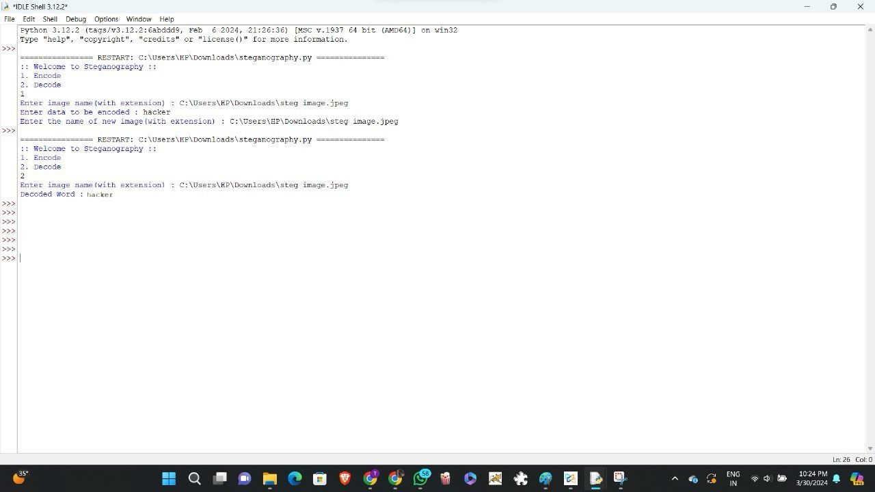

MODELLING
3/21/2024 Annual Review

Slide 12
RESULTS
In general, the results of image steganography encryption include:
- Embedding of secret data within the image without visibly altering it
- Ensuring that the embedded data is hidden and secure from unauthorized access
- Choosing an appropriate algorithm or method for encrypting the data within the image
- Generating a stego image that can be shared or transmitted without suspicion
On the other hand, the results of image steganography decryption involve:
- Extracting the hidden data from the stego image using a decryption algorithm or key
- Reconstructing the original data that was encrypted within the image
- Ensuring that the extracted data is accurate and unaltered from the original
- Verifying the authenticity of the extracted data and confirming it against the original information
Demo Link
3/21/2024 Annual Review

